Slide 1
From Córdoba to Pavia:
A Pharmaceutical Technology Journey
Alejandro J. Paredes, PharmD, PhD
Contact: alejandrojparedes@gmail.com

Slide 2
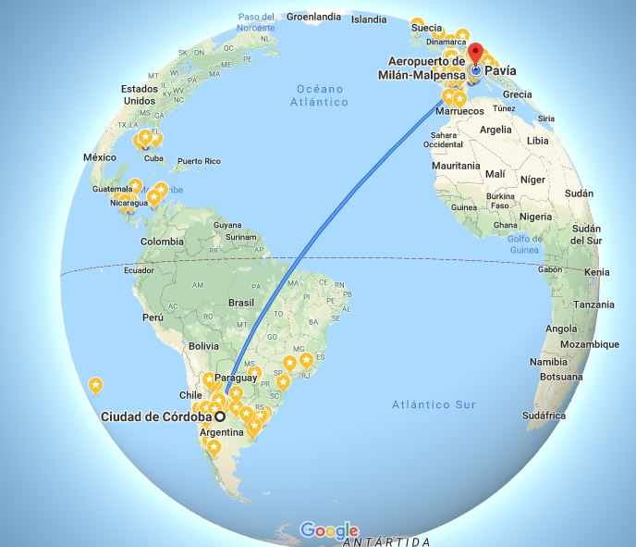

Slide 3
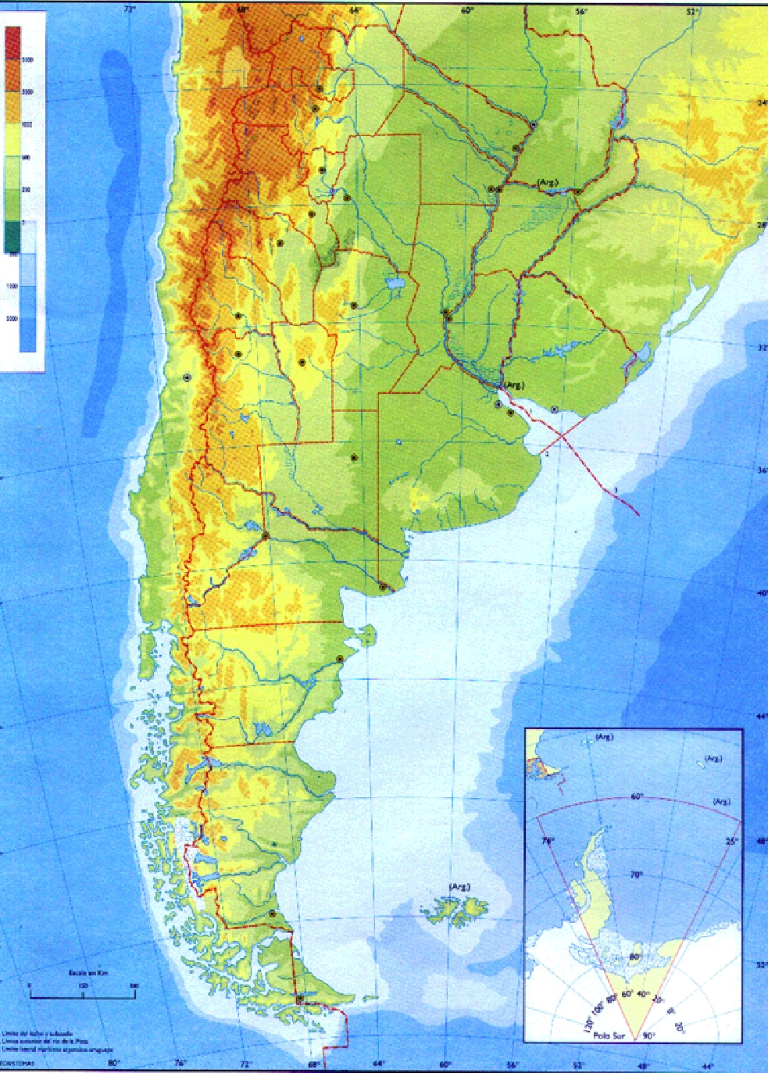
ARGENTINA
Capital City: Buenos Aires
44.27 million of inhabitants
Democratic country
Current President: Mauricio Macri
Poverty: 30%
Inflation: 35%
1 Euro= AR$ 50

Slide 4
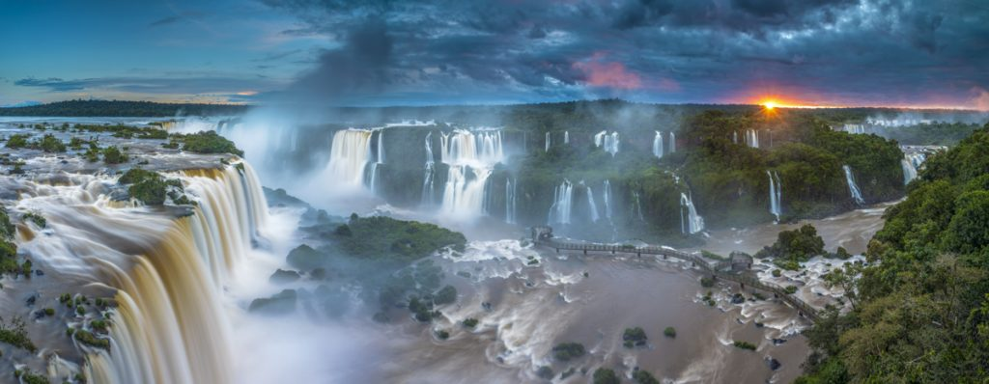
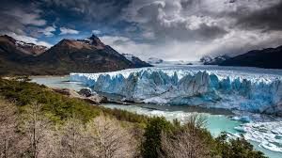
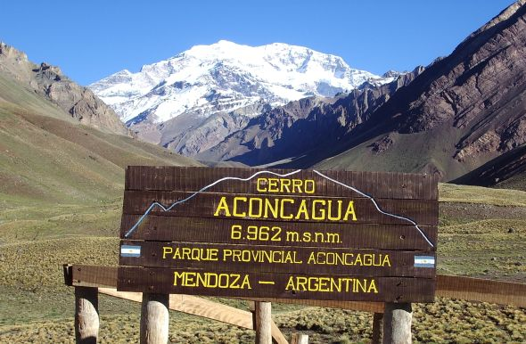
ARGENTINA
Iguazú falls
Perito Moreno Glacier
Mount Aconcagua
(6962 masl)

Slide 5
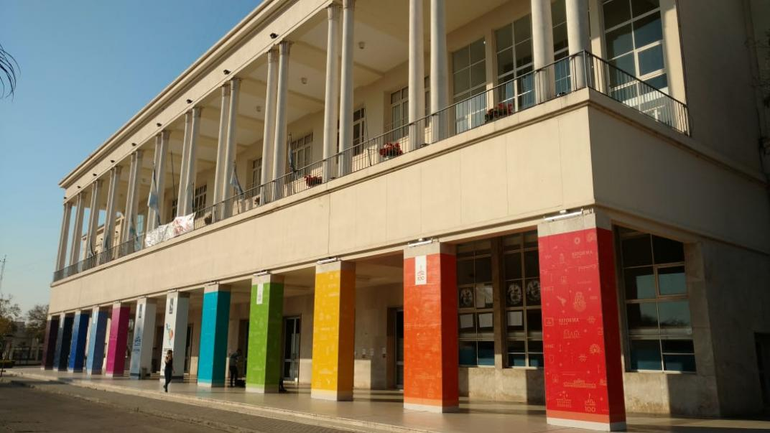
National University of Córdoba

Slide 6
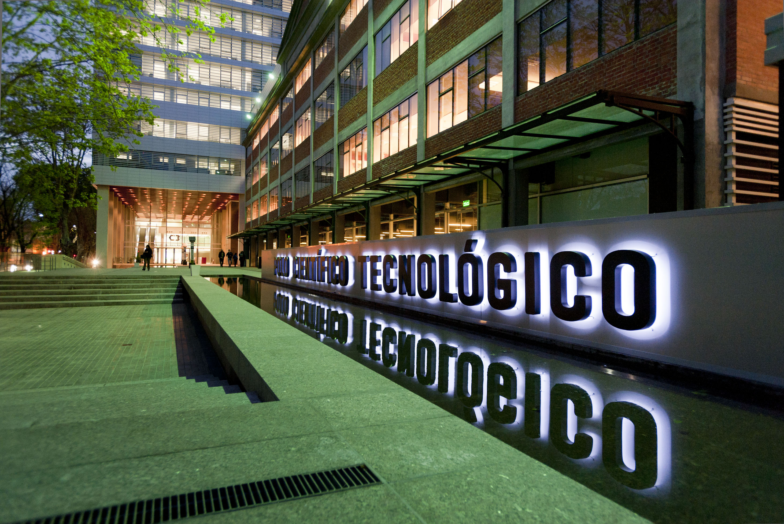
National Council of Scientific and Technological Reserch (CONICET)

Slide 7
¿What is Research in Pharmaceutical Technology?

Slide 8
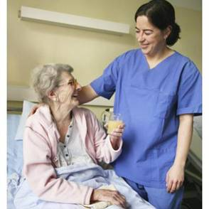
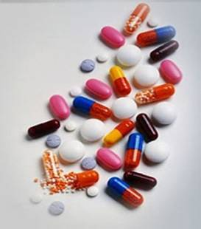
Patients don´t take only drug substances, they take Drug Products (medicinals) that are Pharmaceutical dosage forms

Slide 9
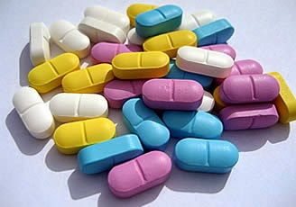
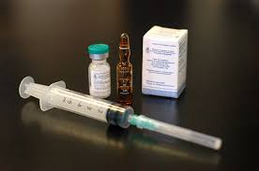
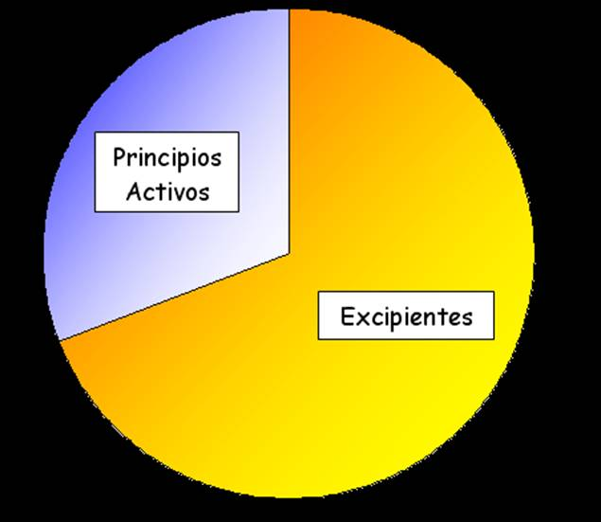
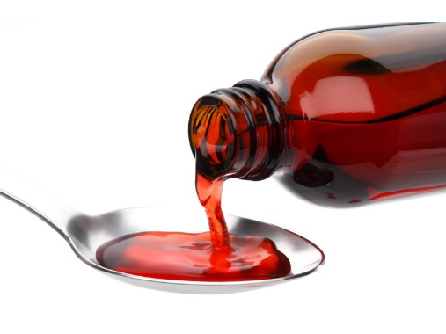
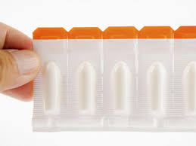
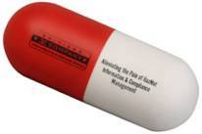
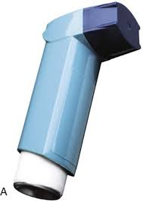
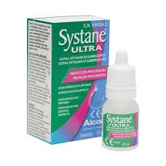
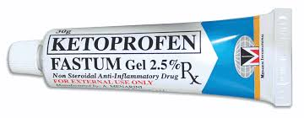
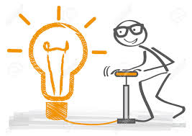
Drug substance
Excipients
Introducción
Notes:
Also nutraceuticals! Which are not drugs by themselves

Slide 10
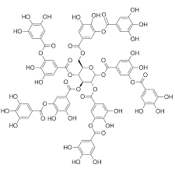
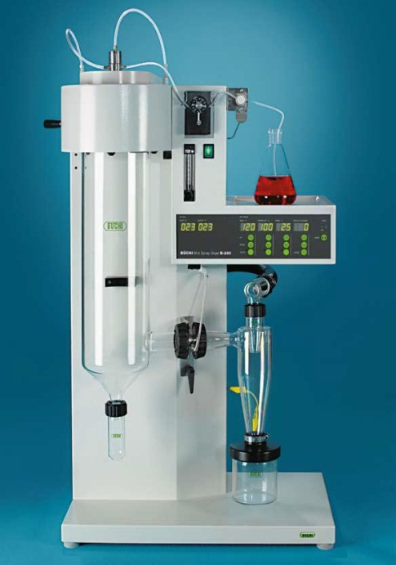
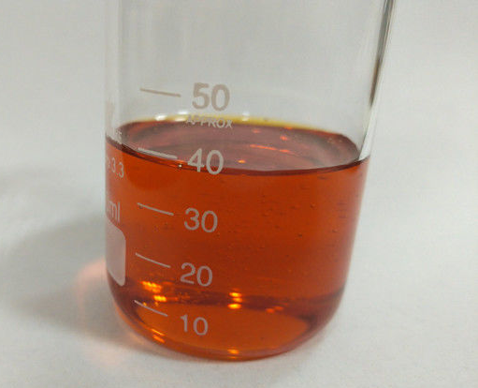
PROJECT IN PAVIA
Polyphenols

Slide 11
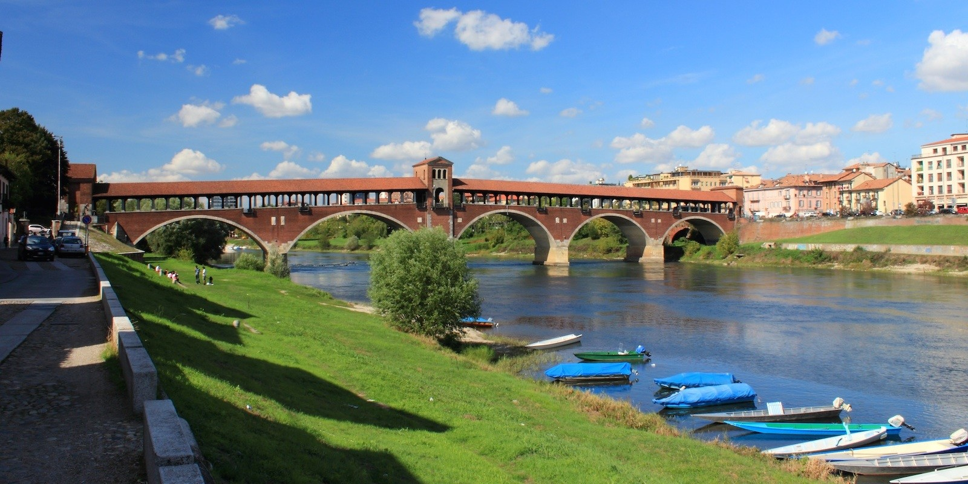
THANKS FOR YOUR ATTENTION

