Slide 1




Title of Contribution
A DNA-based chaos algorithm for an efficient image encryption application
Authors and
Affiliations
J.D.D. Nkapkop^{1,2}
¹Department of Physics, Faculty of Science, University of Ngaoundéré, Ngaoundéré, Cameroon.
²Department of Communications, Faculty of Electronics, Telecommunications
and Information Technology, Technical University of Cluj-Napoca,
Cluj-Napoca, Romania.
April 2019

Slide 2


Outline
Cameroon ??
University of Ngaoundere
CVML
Research Project
Concluding remarks
References

Slide 3
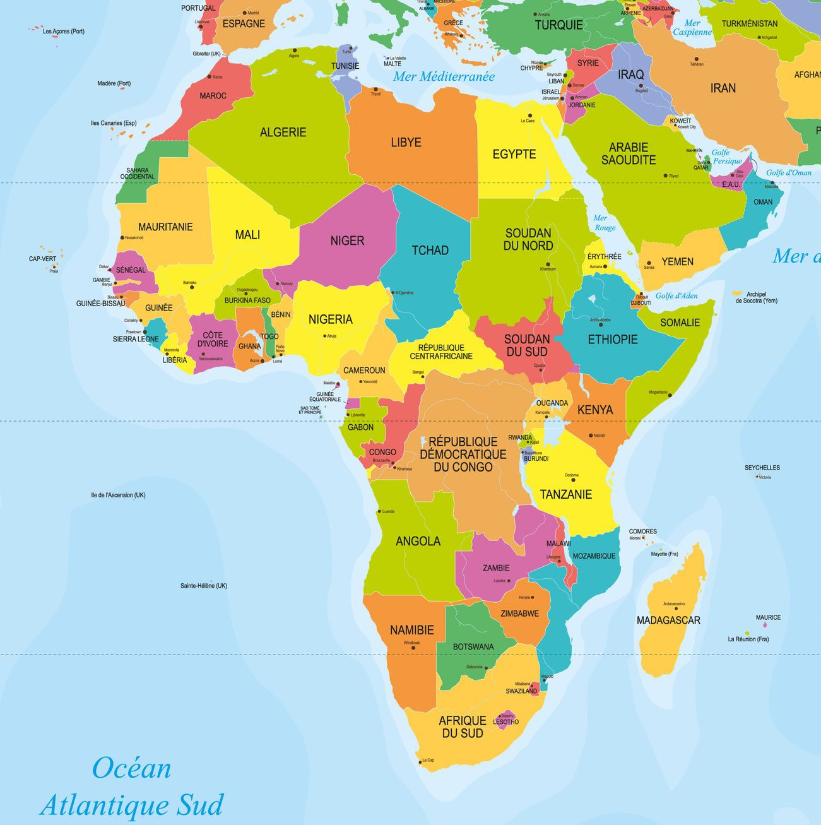
Cameroon ??
54 Countries
16/54

Slide 4
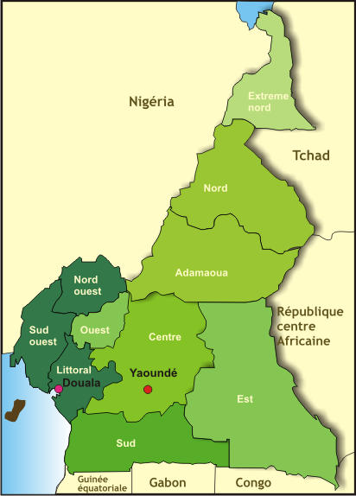

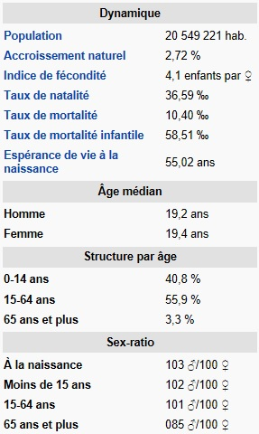


Cameroon ??
UM
UN
UBa
UDs
UY1
UB
UD
UY2

Slide 5
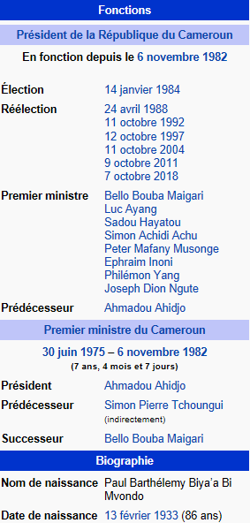

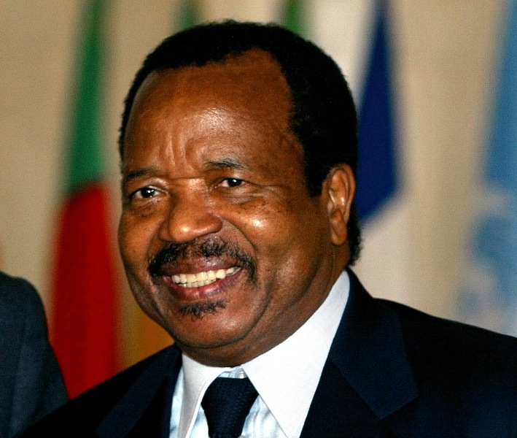
Cameroon ??
37 Years
His Excellency Paul Biya
05 Months
07 Elections
The President of the Republic of Cameroon

Slide 6
Cameroon ??
UN
University of Ngaoundéré
06 Major Schools
IUT
06 Faculties
FALSH
ENS
ENSAI
ESMV
EGEM
EGCIM
FSJP
FSEG
FSE
FMSB
FS
ablissements
20 000 Students
343 Lecturers
Deparment of Chemestry
Deparment of Biological Science
Department of Earth Science
Department of Biomedical Science
Department of Mathematics and Computer Science
Department of Physics
Automatics, Electronics
Image Processing
Electrical Engineering
Mechanics

Slide 7


Cameroon ??
UN
CVML
Department of Electrical, Computer and Biomedical Engineering of the University of Pavia
Director of CVML
Pr. Virginio Cantoni
Full Professor
virginio.cantoni@unipv.it - +39 0382 985358
Advisor
Pr. Luca Lombardi
Associate professor
Luca Lombardi - luca.lombardi@unipv.it - +39 0382 985363

Slide 8
Cameroon ??
UN
CVML
Research Project
A DNA-based chaos algorithm for an efficient image encryption application
Why image encryption ??
Confidentiality Integrity authenticity
For this purpose, many traditional encryption algorithms can be used
DES 3DES AES
but some of these algorithms are hard to understand, slow for encryption and not suitable for real time applications.
The challenge ??
Highly secure Fast (real time) Simple

Slide 9
Cameroon ??
UN
CVML
Research Project
Chaos ??
1
Quasi-randomness (deterministic)
2
3
5
High sensitive dependence on initial conditions and control parameter
Irreproducible and unpredictability
Irregular in time (aperiodic)
4
Infinite number of state

Slide 10
Cameroon ??
UN
CVML
Research Project
Why chaos ??
providing simple mechanisms to generate deterministic pseudo randomness
capability of producing quite complex patterns of behavior from simple real systems or in simulations from low dimensional systems given by a small set of evolution equations
solution to a cost-effective and foolproof encryption technique
simple implementation by hardware and software at low cost
Notes:
Moreover, generating chaotic values is often of low cost with simple iterations, which makes it suitable for the construction of stream ciphers. Therefore, cryptosystem can provide a secure and fast means for data encryption, which is crucial for data transmission in many applications.

Slide 11
Cameroon ??
UN
CVML
Research Project

Slide 12
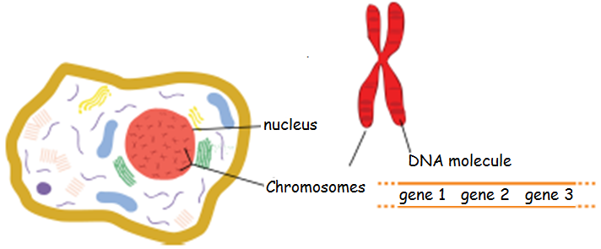

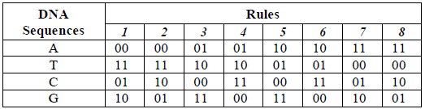
Cameroon ??
UN
CVML
Research Project
DNA ??
Where A and T are
complementary,
as well as G and C.
Figure 1: Cell and its genetic material.
Table 1: Eight encoding rules for DNA sequences.
Notes:
In image encryption, this complementarity can be translated into binary complementarity satisfying the Watson-Crick rule [1]

Slide 13
DNA in cryptography
DNA cryptography??
1
a new and promising field in information security
2
3
combines classical solutions in cryptography with the strength of the genetic material
benefit from the advantages of the classical cryptosystems and solve some of its limitations.

Slide 14
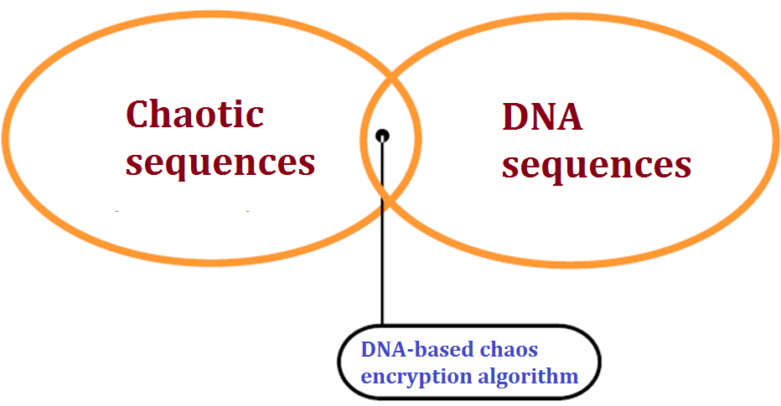
Cameroon ??
UN
CVML
Research Project
Concluding remarks
Contribution ??
A new symmetrical image encryption algorithm based on the combination of DNA and chaotic sequences;
A demo software, to display its implementation in C++ language under Qt environment.

Slide 15
Cameroon ??
UN
CVML
Research Project
Concluding remarks

Slide 16

Acknowledgement
With the supports of :

Slide 17
References
[1] M. Seyedzadeh, and S. Mirzakuchaki, “A fast color image encryption algorithm based on coupled two-dimensional piecewise chaotic map,” Signal processing, vol. 99, pp. 1202–1215, 2012.
[2] X. Chai, Y. Chen, and L. Broyde, “A novel chaos-based image encryption algorithm using DNA sequence operations,” Optics and Lasers in Engineering, vol. 88, pp. 197–213, 2017.
[3] X.-Y. Wang, Y.-Q. Zhang and X.-M. Baom, “A novel chaotic image encryption scheme using DNA sequence operations,” Optics and Lasers in Engineering, vol. 73, pp. 53–61, 2015.
[4] C. Song, and Y. Qiao, “A novel image encryption algorithm based on DNA encoding and spatiotemporal chaos,” Entropy, vol. 17, pp. 6954–6968, 2015.
[5] P. Zhen, G. Zhao, L. Min, and X. Jin, “Chaos-based image encryption scheme combining DNA coding and entropy,” Multimed Tools Appl, vol. 75, pp. 6303–6319, 2016.
[6] H. Liu, X. Wang, and A. Kadir, “Image encryption using DNA complementary rule and chaotic maps,” Applied Soft Computing, vol. 12, pp. 1457–1466, 2012.
[7] A. Rehman, X. Liao, M. Hahsmi, and R. Haider, “An efficient mixed inter-intra pixels substitution at 2bits-level for image encryption technique using DNA and Chaos,” Optik, vol. 153, pp. 117-134, 2018.
[8] T. Hu, Y. Liu, L.-H. Gong, and C.-J. Ouyang, “An image encryption scheme combining chaos with cycle operation for DNA sequences,” Nonlinear Dynamic, vol. 87, pp. 51–66, 2017.

Slide 18
Thank you for your kind
attention

